Slide 1
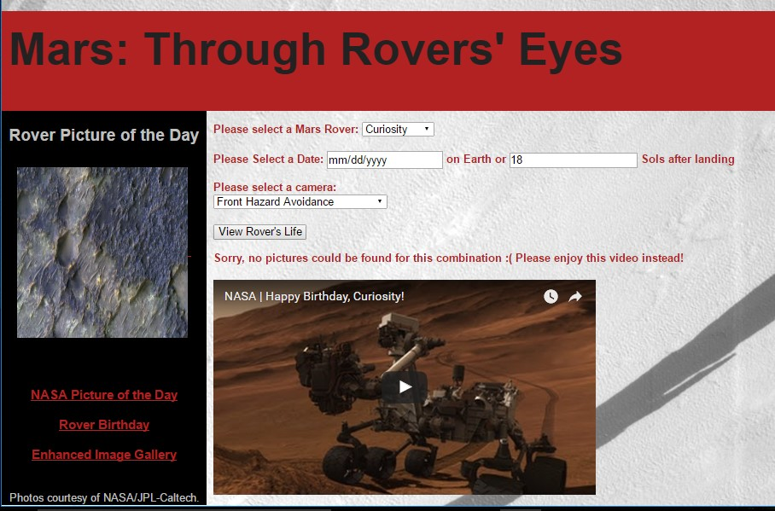
Buckeyes, Tigers, & Bulldogs, oh my! Summary
Web site solution coded in html5, Javascript, and Jquery in Aptana Studio 3
Background & Pic of the Day are cleaned images taken by Curiosity
Error message shows NASA Youtube video
Team members: Makenzie Neeley & Victoria Platt

